Slide 1
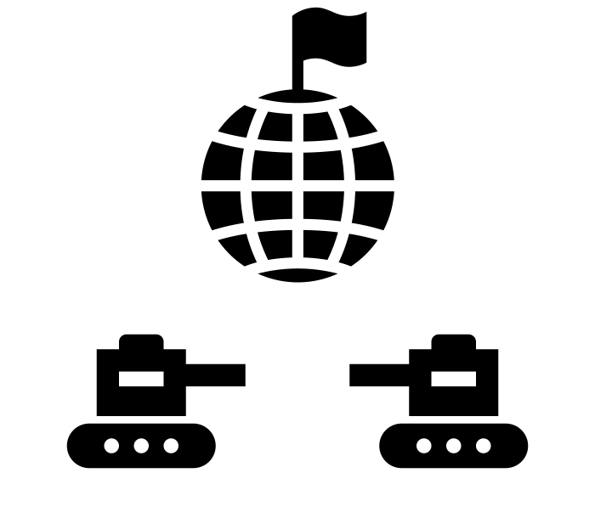
What will you be learning in Year 8?
How can cities be sustainable?
Shenzhen – a growing city
What is urbanisation?
YEAR
9
World Cities
What are the impacts of tourism in Peru?
Assessment
The impacts of urbanization in Lagos
Why is Jakarata sinking?
What are the impacts of tourism in Kenya?
What impacts can leaders have on a country?
What is it like in South America?
Favelas: a city within a city?
Why are rainforests so important?
EXAM WEEK
Damming the Nile
Can we save the rainforests?
Types of rainfall
Introduction to Africa
Exploring Africa
Exploring South America
Weather
Factors affecting climate
Why does the Nile flood?
Assessment: Should the Nile be dammed?
How developed is Africa?
Why do people migrate?
Is South America a dangerous place to live?
What is it like in a tropical rainforest?
What are the causes and effects of deforestation?
Assessment
Weather in the UK overview
How can we measure weather?
How does The Middle East’s physical and human geography vary?
Coping with conflict
.
8
The Middle East
YEAR
Assessment
Dubai, a sustainable city on sand?
The Middle Easts Changing Population
An intro to The Middle East
Keep a track of your progress here:
Autumn 1
ATL
Assessment mark
Summer 1
ATL
Assessment mark
Summer 2
ATL
Assessment mark
Autumn 2
ATL
Assessment mark
Spring 1
ATL
Assessment mark
Spring 2
ATL
Assessment mark
Notes:
Year overview – more detailed overview of the year – to include the ‘why’ at the top. – this bit needs working on to make the ‘why’ more catchy.
Unit over view.
Not final version yet – not very pretty, just thrown around some ideas on there so far. Or useful! Apart from the table to record the data in. which I’m also not sure about.

