Slide 1
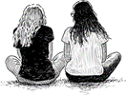
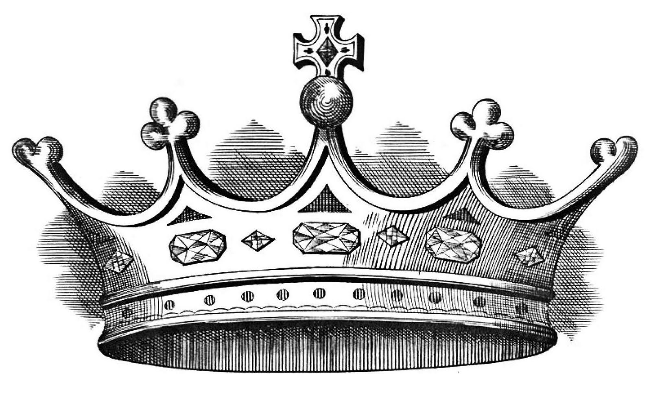
Central
Resource Bank
Summer 2
ATL
Final Lectures
Final Exam Prep
Revision
Reflection
Macbeth
Language Paper 1
Summer 1
ATL
Performance Reflection
Deeper Connections
Language
Paper 2
Anita & Me
Relationships
Poetry
Central
Resource Bank
Writing style refinement
Application of Critical Theory
A Christmas
Carol
Spring 2
ATL
Shakespeare Project
Summer 2
Summer 1
Mastery of TEALEAC
Spring 1
Spring 1
ATL
Spring 2
Relationships Poetry
A Christmas Carol
Language Paper 1
Conventions
of a Tragedy
Critical Theory
Fatal Flaw
Autumn 2
ATL
Tragic Hero
Macbeth
Autumn 1
Mastery of
TEALEAC
Thesis
Statements
Autumn 2
Autumn 1
ATL
Appearance Vs Reality
Year 11 Learning Tree

