Slide 1
WHY CHOOSE Art and Design?
Not just about drawing pictures

Slide 2
time management, research skills, communication, diplomacy, delegation, resilience, articulation, teamwork, creative thinking, ideas, identifying target market, building confidence in others, web development, social media, lateral thinking, negotiation, creative problem-solving, technical ability, risk-assessment, budgeting, self-direction, visual literacy, independence, networking, working to deadline, flexibility, interpersonal skills, passion, empathy, curiosity, dedication, perseverance, adaptation, patience, listening, speaking

Slide 5
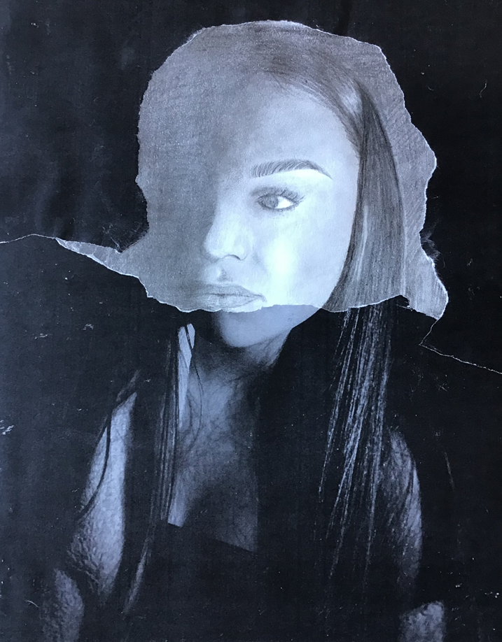
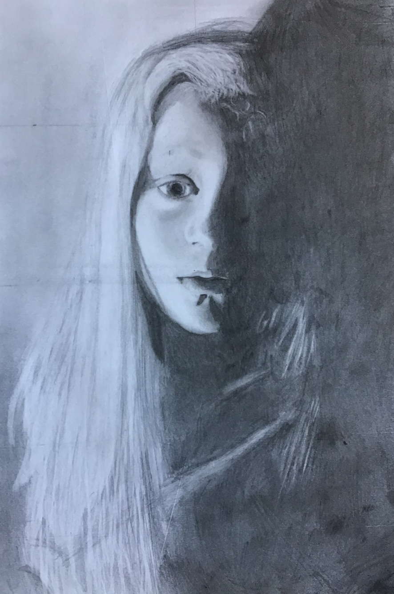
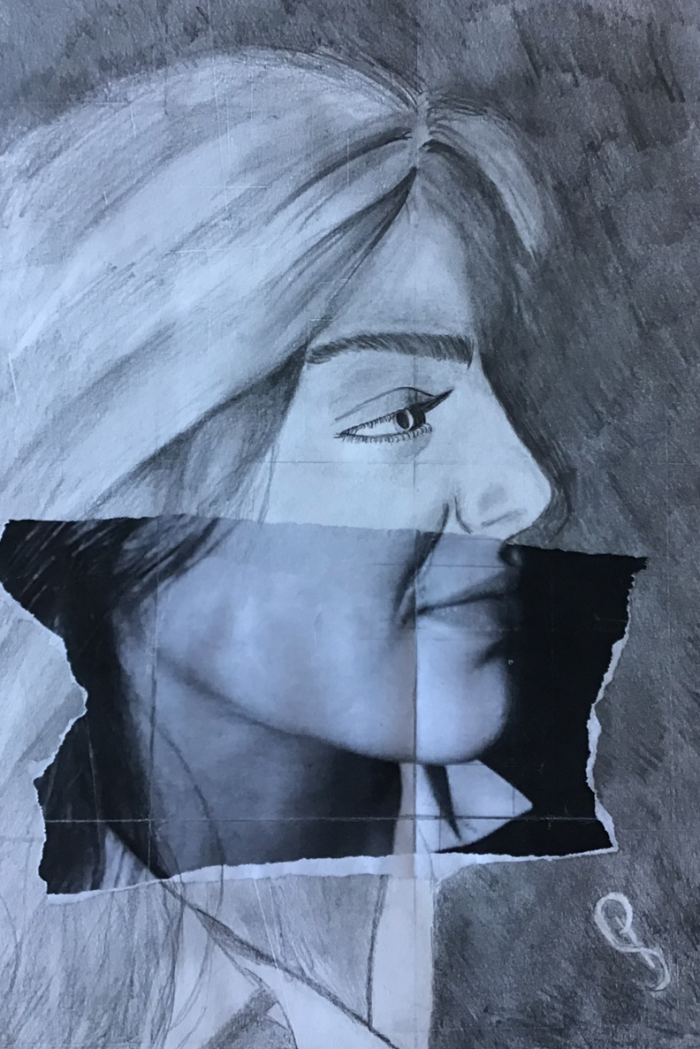
FIRST 3 WEEKS -
FOCUS ON DRAWING

Slide 6
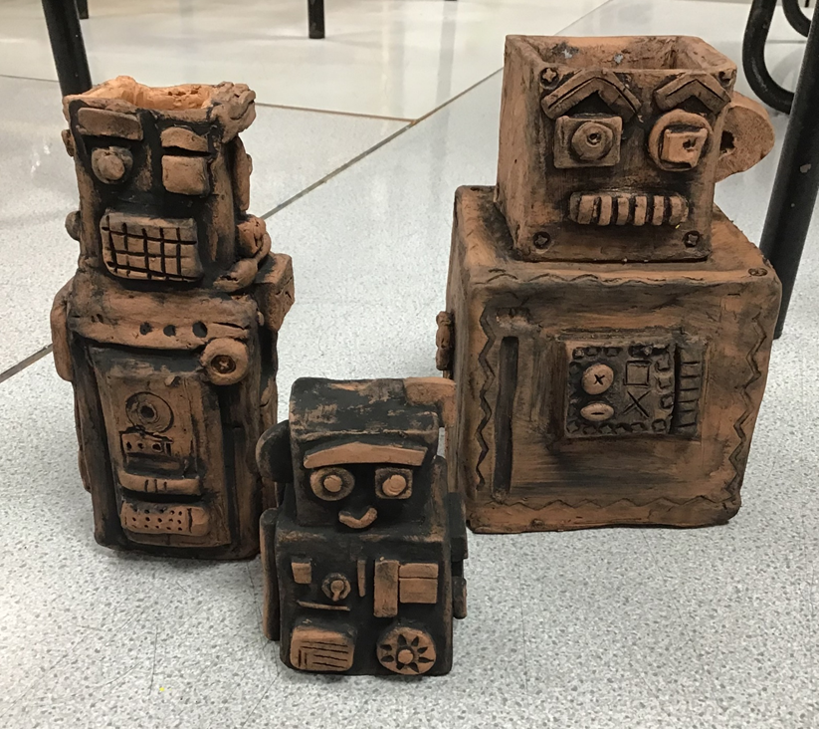
TERRACOTTA ROBOTS WITH COPPER OXIDE GLAZE

Slide 7
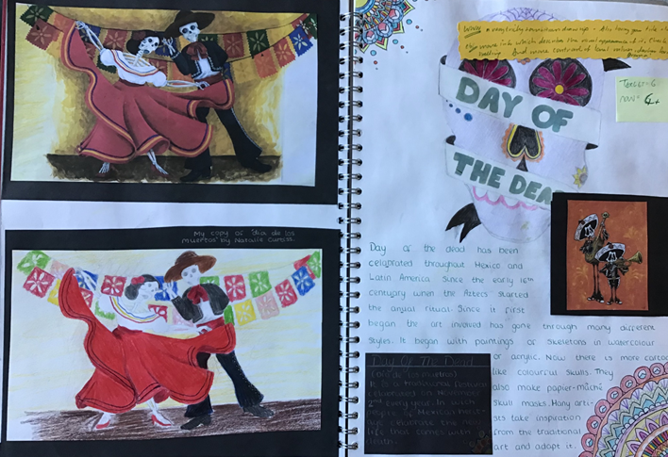
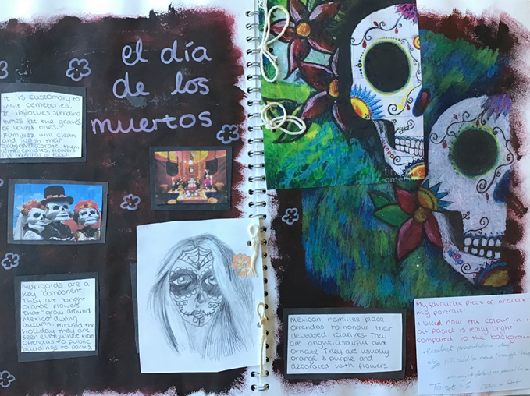
LOOKING AFTER YOUR WORK AND PRESENTING IT CREATIVELY IN A SKETCHBOOK

Slide 9
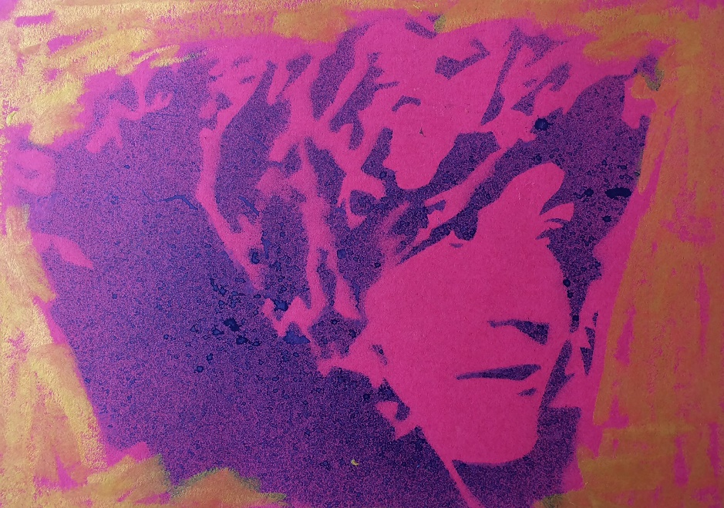
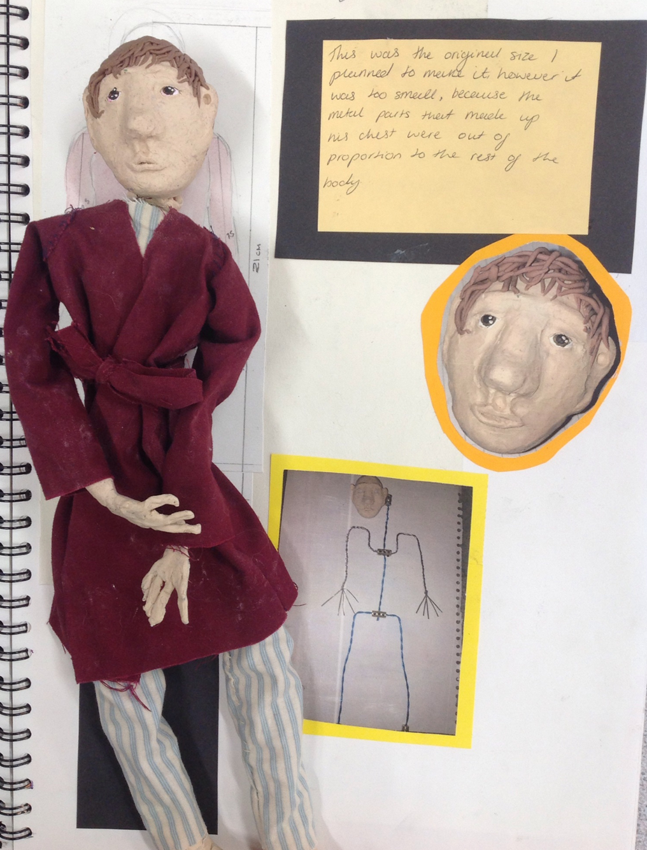
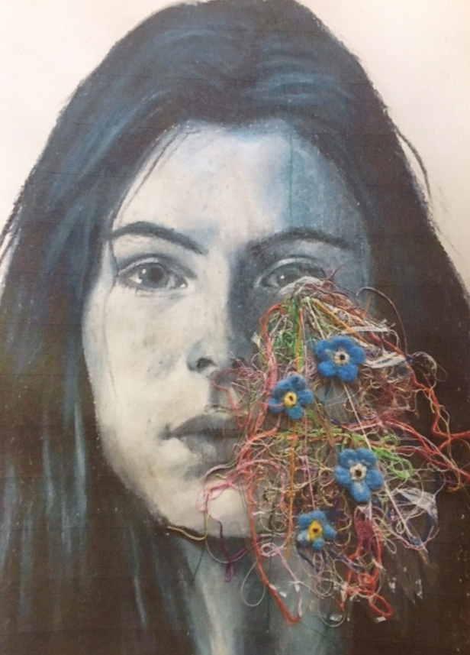
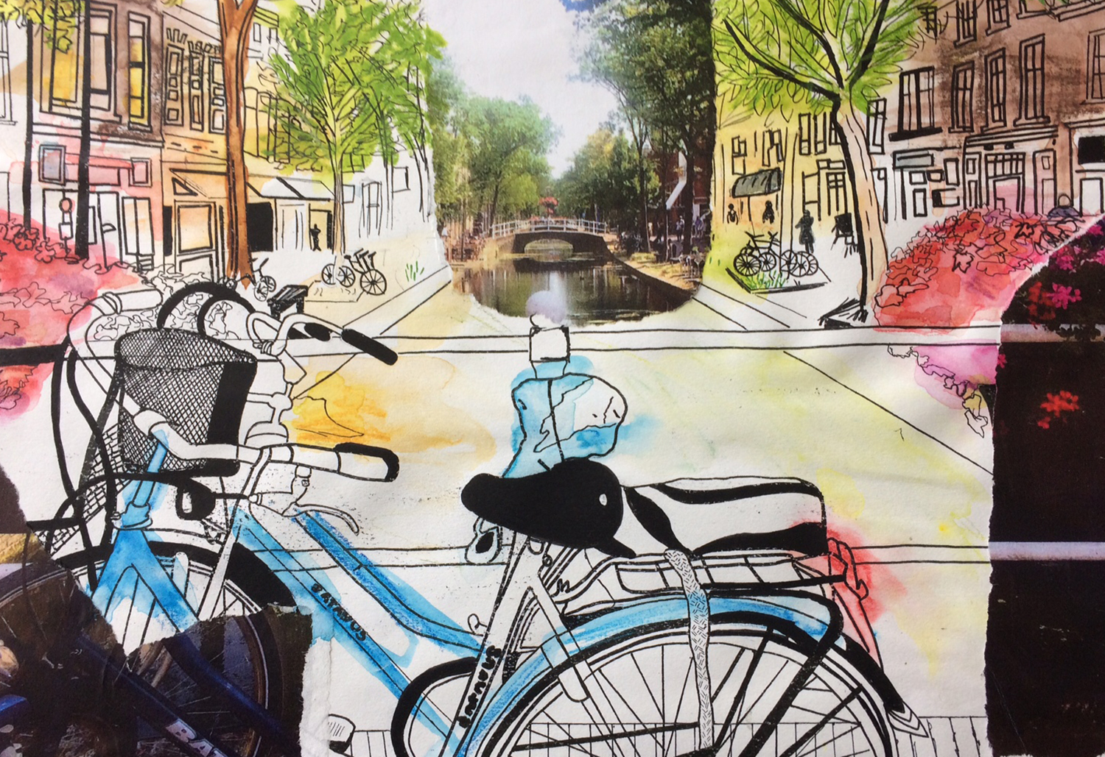
YOU’LL BE EXPECTED TO INVESTIGATE A RANGE OF MEDIA
IT’S YOUR CHOICE
STENCILLING, TEXTILES, DIGITAL DRAWINGS, PRINT MAKING PHOTOGRAPHY, SCULPTURE…

Slide 10
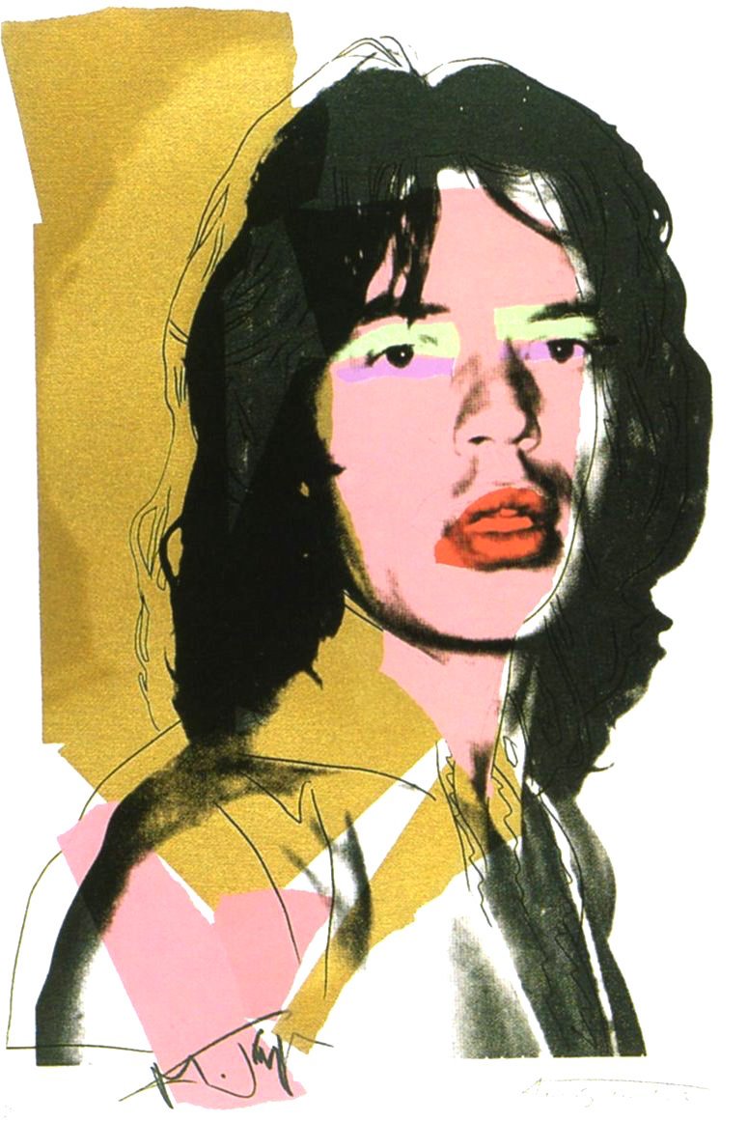
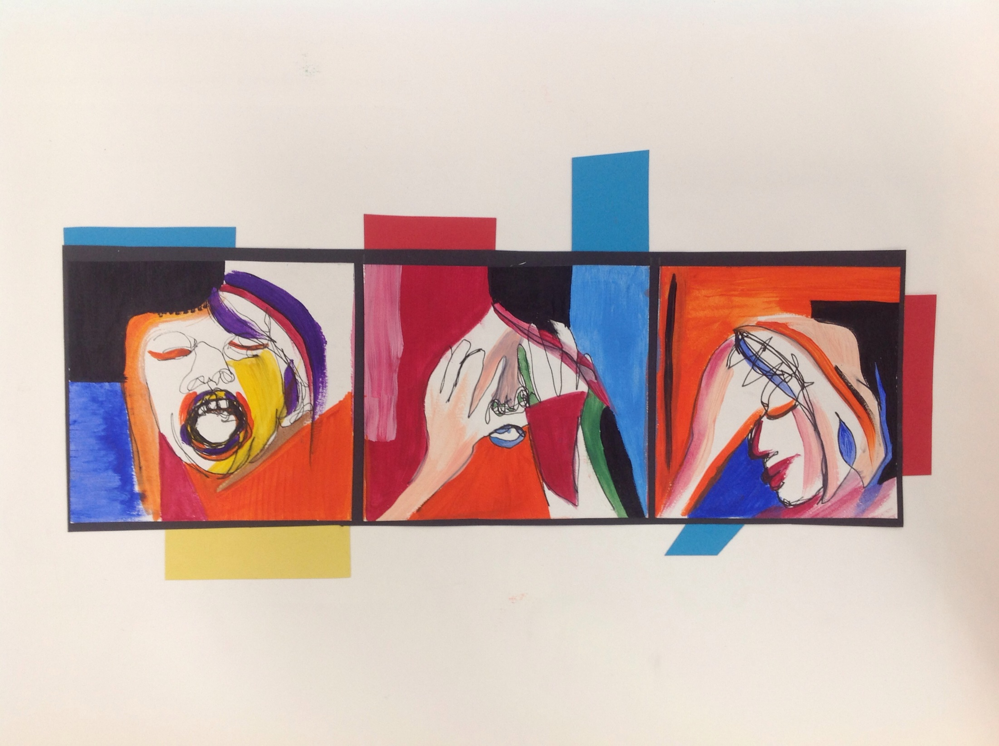
YOU WILL STUDY ARTISTS OF YOUR CHOICE AND PRODUCE CREATIVE RESPONSES TO THEIR WORK WHERE YOU’LL NEED TO DEMONSTRATE YOUR UNDERSTANDING OF THEIR STYLE AND CONCEPT

Slide 11
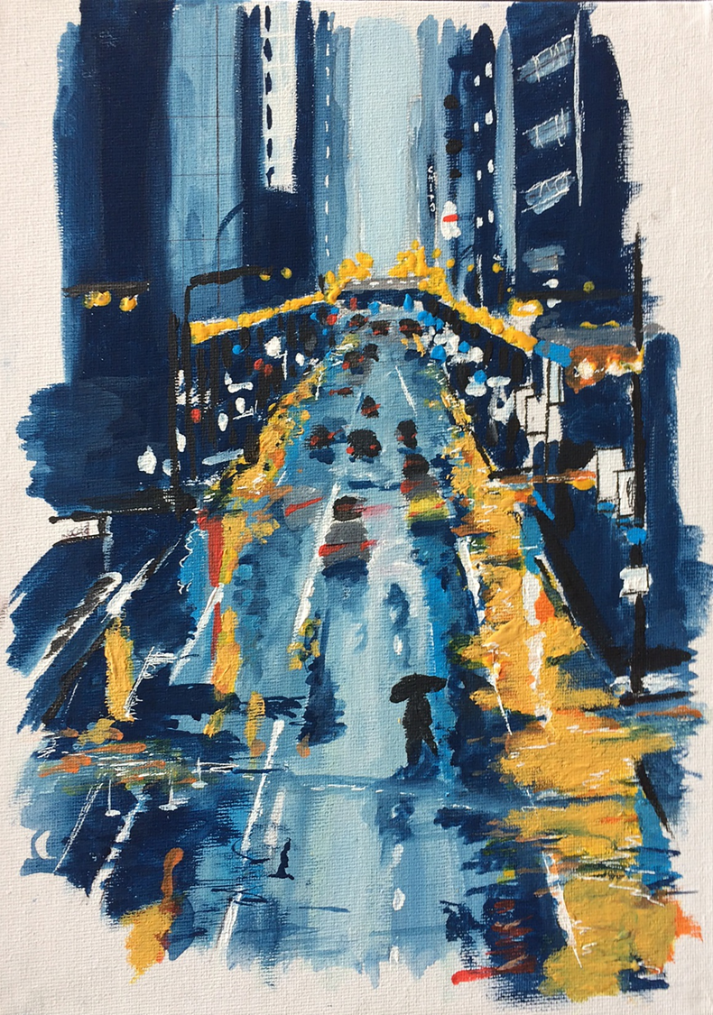
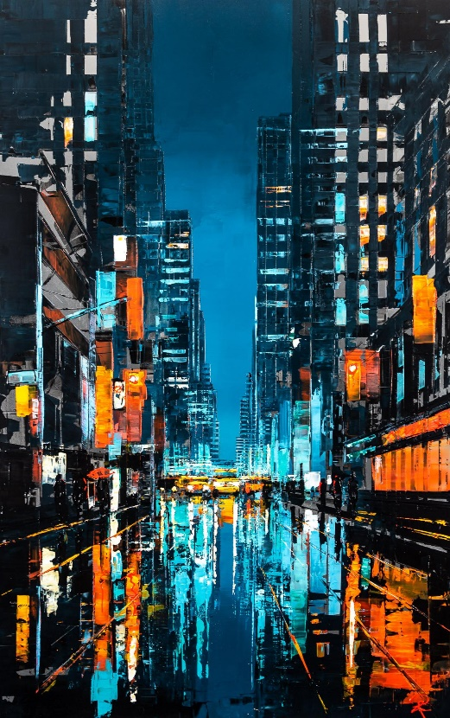
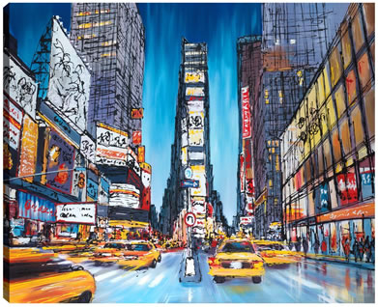
EXPLORING THE WORK OF PAUL KENTON USING ACRYLIC PAINT

Slide 12
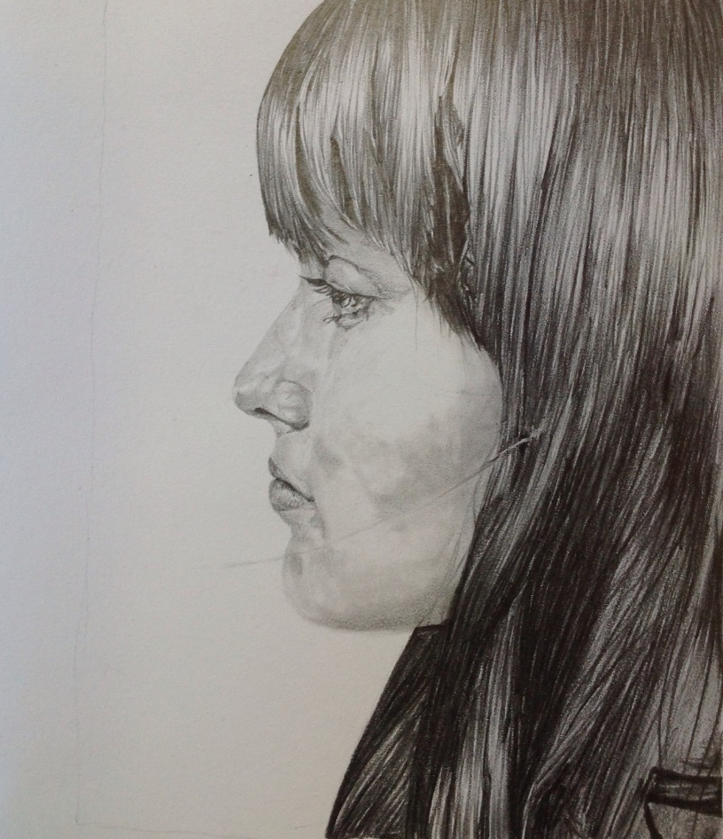
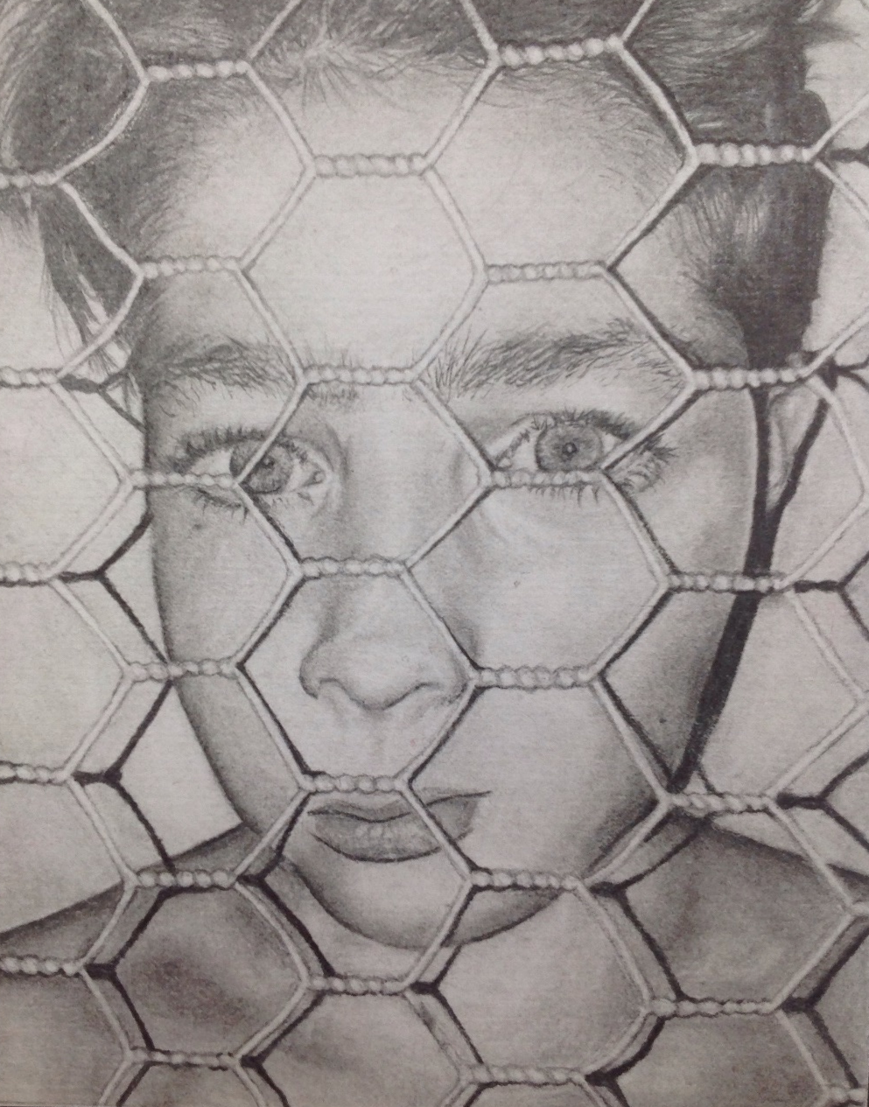
You’ll be expected to work from your own creative photography

Slide 13
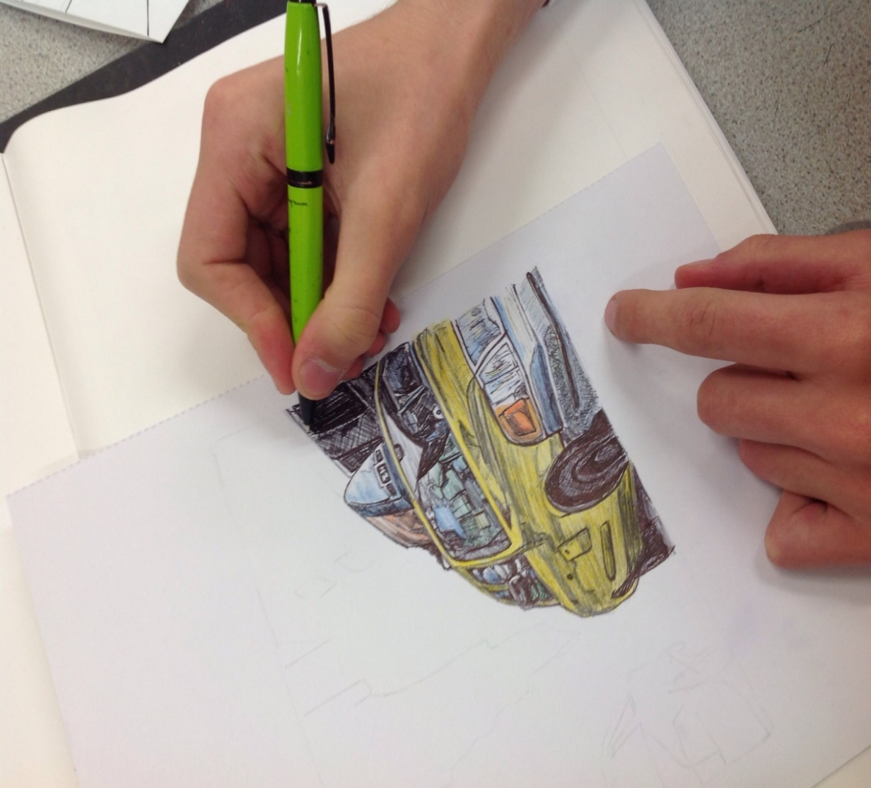
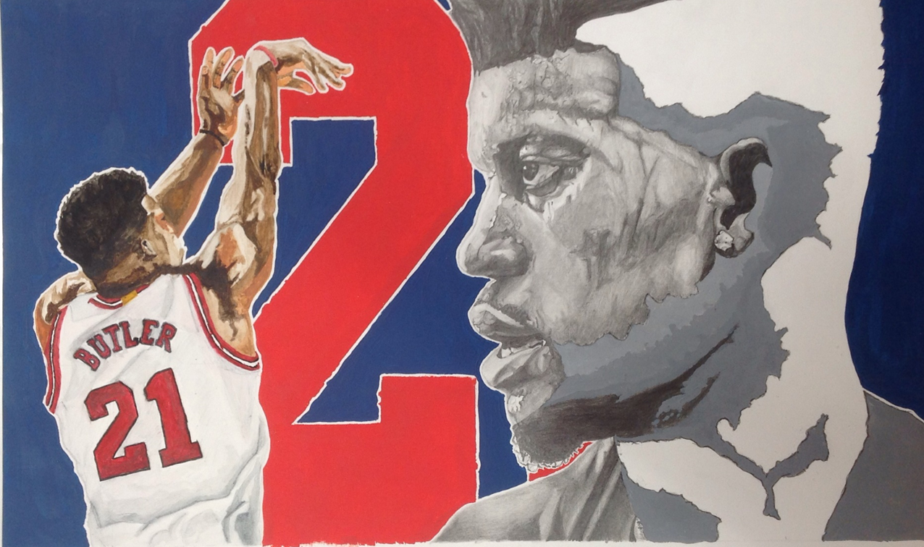
AND PRODUCE CREATIVE RESPONSES FROM IMAGES YOU HAVE SOURCED YOURSELF

Slide 14
